Slide 1
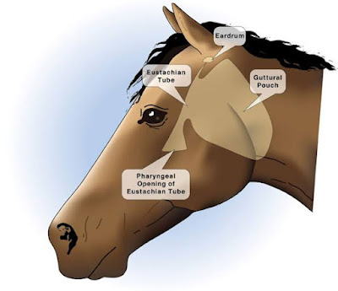
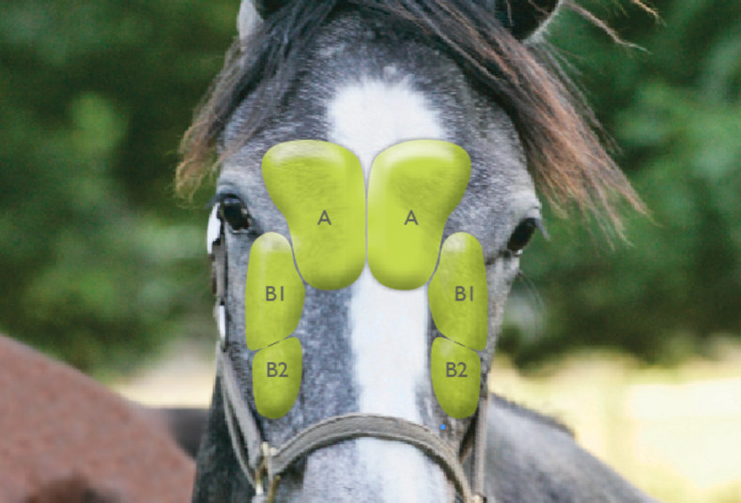
Affection of paransal sinsuses and guttural pouch
Dr. Alaa Ahmed Ibrahim
Department of veterinary surgery &obstetric
College of Veterinary medicine University of Basrah

Slide 2
Surgical anatomy
Horse paranasal sinus system consists of six pairs of sinuses:
Dorsal (endoturbinate I)
Middle (endoturbinate II)
Ventral nasal conchal sinuses
Sphenopalatine sinus
Frontal sinus
Maxillary sinus .
All the sinuses communicate with the nasal cavity directly (maxillary sinus) or indirectly (dorsal, middle, and ventral conchal sinuses; frontal sinus; and sphenopalatine sinuses) through the maxillary sinus.

Slide 3
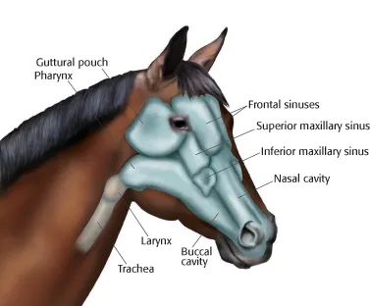
The circles indicate the site(s) of trephination for each sinus, and shaded areas are the frontal and maxillary sinuses.

Slide 4
Function of the paranasal sinuses
Functions of the paranasal sinuses are somewhat not clear .The suspected functions are :-
Resonating cavities
Limiting the weight of the skull
Cooling of the brain
Increased insertion space for teeth

Slide 5
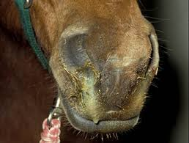
Sinusitis
Sinusitis is the most common disease
of the paranasal sinuses
This disease may be primary or
secondary and chronic or acute
Primary bacterial sinusitis usually results from previous upper respiratory tract infections.
Streptococcus species are the most commonly reported organisms of primary sinusitis.
Frontal sinusitis in cattle associated with dehorning
Maxillary sinusitis associated with infected teeth
Dental disease is the most common cause of secondary sinusitis

Slide 6
Secondary sinusitis is generally more difficult to treat and requires surgical intervention to remove the underlying cause
Secondary sinusitis may be caused by dental disease, facial fractures, granulomatous lesions, or neoplasms
Identify sinusitis causes by laparoscope and endoscope is difficult in the presence of exudate in sinus ,therefor removal of exudate may enhance the radiographic and endoscopic examination of the sinus

Slide 7
Clinical signs of paranasal sinusitis
Primary clinical signs are unilateral nasal discharge, facial swelling, and decreased nasal airflow
Occasionally seen clinical signs are externally draining tracts, malodorous breath, ocular discharge,
Nasal discharge may be serous, purulent, mucopurulent, or serosanguineous, but hemorrhage usually indicates granulomatous or neoplastic lesions
Frontal sinusitis occurs immediately after dehorning because the wound is still open.

Slide 8
Principles of treatment of sinusitis
Treatment of primary sinusitis by provide adequate drainage and to use systemic antimicrobial agents based on antibiotic culture results and sensitivity testing
Drainage may be enhanced by lavaging the sinus once or twice daily
Drainage and lavage are accomplished by either placing an indwelling catheter percutaneously into the maxillary sinus or by using a small, sterile, flexible plastic stallion catheter through a trephine opening in the frontoconchal sinus.

Slide 9
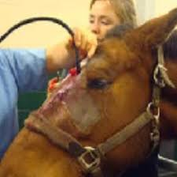
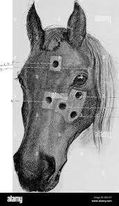
Surgical treatment includes removal of the exudate from the ventral conchal sinus and providing additional drainage if necessary. The ventral conchal sinus can be accessed via a maxillary bone flap or by trephining the frontal sinus in the standing horse

Slide 10
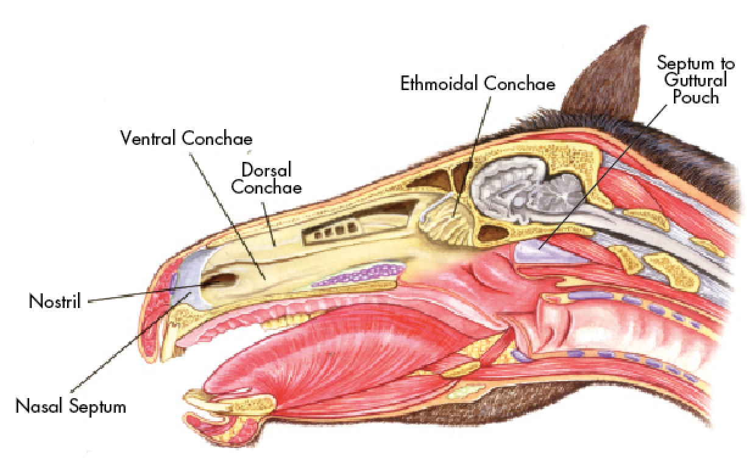
Paranasal Sinus Cysts
Exact cause and pathogenesis of paranasal cyst are unknown but suspected to be of dental origin
There is some evidence that these cysts may have a common origin with ethmoid hematomas

Slide 11
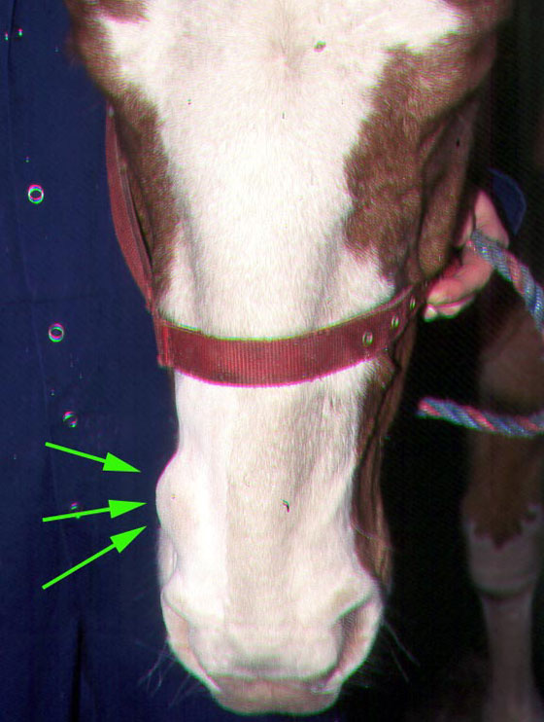
Clinical signs of paranasal sinus cyst
The most common clinical features are dyspnea, facial swelling, and nasal discharge
When the cysts expand can lead to obstruction of the common nasal meatus and possibly deviation of the nasal septum and facial deformity.
The cysts are typically filled with a yellow, viscous fluid unless they become secondarily infected.

Slide 12
Treatment of paranasal sinus cyst
Surgical management consists of removing the cysts completely, establishing drainage, and repelling any teeth that may be involved.
Bone flap technique is only the way used to provide complete sinus exposure
in young, growing horses regression of the nasal obstruction and facial deformity after surgery are reported

Slide 13
Paranasal sinuse neoplasia
Most common tumor of the paranasal sinuses is squamous cell carcinoma
Other invasive tumors reported include spindle-shaped sarcoma ; osteogenic sarcoma, lymphosarcoma, and a poorly differentiated carcinoma ;hemangiosarcoma; and adenocarcinoma.
The prognosis is generally negative unless the neoplasm is a solid noninvasive tumor, because the majority are malignant

Slide 14
SURGICAL APPROACHES TO THE PARANASAL SINUSES
Surgical access to the paranasal sinuses can be obtained by
either trephination or bone flap techniques
Bone flap techniques provide better exposure than trephination for the following reasons :
They provide better exposure, visualization, and access for surgical manipulation within the sinuses
They eliminate the need for multiple trephine openings.

Slide 15
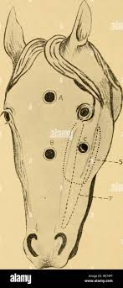

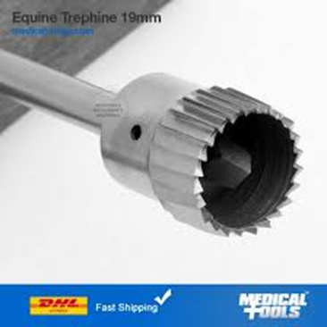
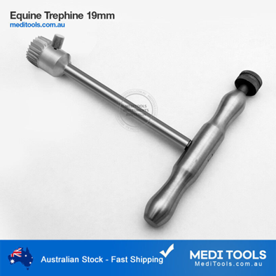
Trephination
Trephination is the traditional approach for surgical access to the paranasal sinuses. It is useful for diagnostic and therapeutic access to the sinuses.
The trephination sites usually heal within 3 to 4 weeks with minimal blemish.

Slide 16
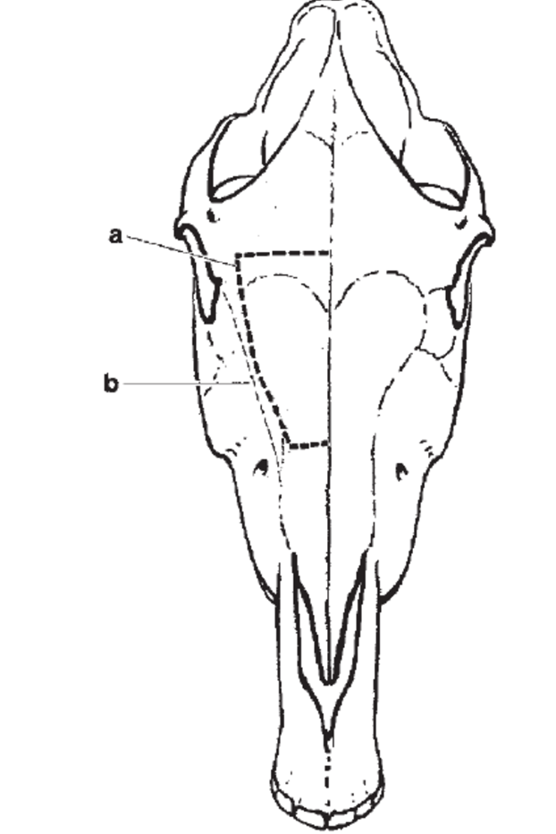
Maxillary bone flap
Frontonasal bone flap

Slide 17
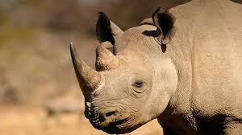
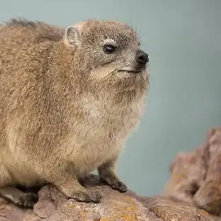
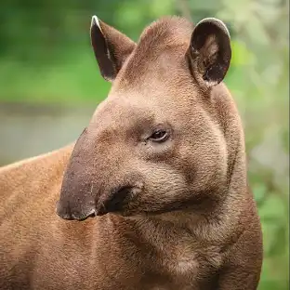
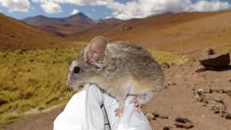
Guttural Pouch
Guttural pouches are paired extensions of the eustachian tubes that connect the pharynx to the middle ear.
They are found in perissodactyls, such as equids, tapirs, some species of rhinoceros (except for the white rhinoceros), some bats, a South American forest mouse, and hyraxes
Hyrax
Tapirs

Slide 18
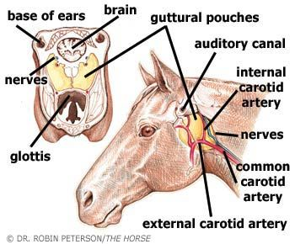
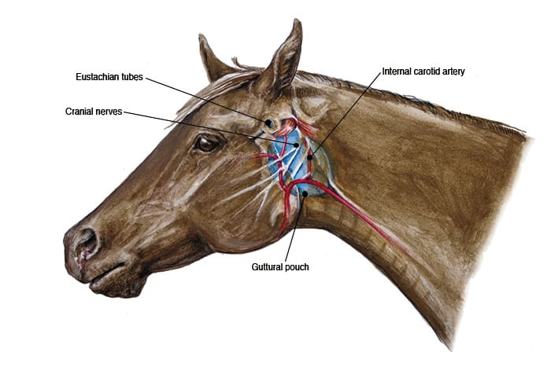
Guttural pouch anatomy
it pair and connects the nasopharynx to the middle ear
The guttural pouches are paired, air-filled spaces that extend from the base of the skull and atlas to the nasopharynx
Each pouch opening at the pharyngeal orifice (approximately 3 cm), located at the dorsolateral aspect of the nasopharyngeal lateral wall, known as the Ostia

Slide 19
Function of the guttural pouch
Function of the guttural pouches in the horse seems to be to cool the brain : guttural pouches function during selective brain-cooling to maintain blood carried by the internal carotid arteries at a temperature below the core body temperature during hyperthermia, induced by exercise (The extracranial portion of the internal carotid artery travels through the medial compartment of the guttural pouch. The temperature of the air within the guttural pouch was fairly constant (37.5 ± 0.05°C)

Slide 20
DISEASES OF THE GUTTURAL POUCH
Guttural pouch tympany – This disease involve distention of one or both guttural pouches with air with some fluid accumulation.
This condition usually unilateral but can be bilateral and seen in horses ranging from birth to 1.5 years of age and is more common in fillies than in colts
Etiology of the tympany is unknown but the most common explanation is that malformation or dysfunction in the mucosal flap (plica salpingopharyngea) which forms the pharyngeal orifice to the guttural pouch, creating a one-way valve and trapping air within the affected guttural pouch.

Slide 21
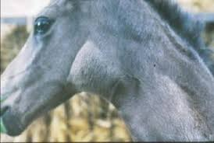
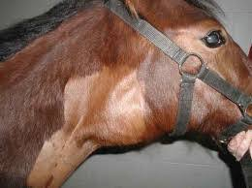
Clinical signs of guttural pouch tympany
Characteristic clinical signs of tympany include a nonpainful, elastic swelling of the parotid region overlying the affected pouch.
Swelling may extend across the neck and give the impression of bilateral involvement
Dyspnea, dysphagia, and inhalation pneumonia result from sever distention of guttural pouch.
Breathing may become difficult in severely affected animals

Slide 22
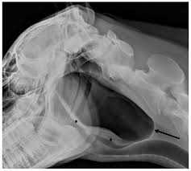
Diagnosis of guttural pouch tympany
Diagnosis is based largely on clinical signs
Guttural pouch enlargement with air and fluid can be seen on radiographs but distinguishing between unilateral and bilateral tympany can be difficult but usually they can be defined on direct endoscopy of each pouch.

Slide 23
Treatment of guttural pouch tympany
Temporary alleviation can be achieved by needle decompression or by placing an indwelling catheter in the pharyngeal orifice; however, surgery is required for definitive treatment
Surgical fenestration of the septum between the affected guttural pouch and the normal one can be performed, to allow air in the abnormal guttural pouch to pass to the normal side and be expelled into the pharynx
Fenestration is generally unsuccessful with bilateral tympany and postoperative prognosis is good in cases without secondary complications
Alternatively, long-term (2-6 weeks) placement of Foley catheters into the opening of each guttural pouch, exiting the nares, can result in remodeling at the plica fold, with permanent resolution of tympany once the catheters are removed.

Slide 24
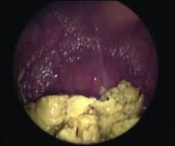
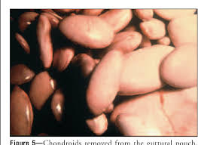
Empyema of the guttural pouches
Empyema is unilateral or bilateral accumulation of purulent exudate and chondroids in the guttural pouch. The infection usually develops subsequent to a bacterial (primarily Streptococcus spp) infection of the upper respiratory tract.
Chondroids consist of inspissated purulent material (usually numerous individual round balls) that forms in some cases
Chondroid material in the guttural pouch serves as a source of chronic infection

Slide 25
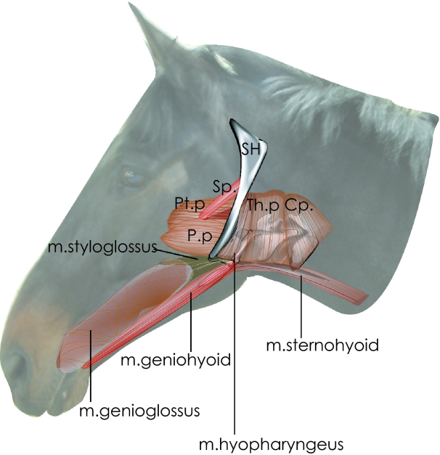
Causes of empyema
Upper respiratory tract infections (especially those caused by Streptococcus)
Abscessation and rupture of retropharyngeal lymph nodes into the guttural pouch
Infusion of irritant drugs
Fracture of the stylohyoid bone
Congenital or acquired stenosis of the pharyngeal orifice
Pharyngeal perforation by a nasogastric
tube

Slide 26
Clinical signs of guttural pouch empyema
Intermittent nasal discharge in most cases
Painful swelling in the parotid area
Extended head carriage (حمل الراس ممتدا)
Excessive respiratory noise, and difficulties in swallowing and breathing
In rare cases pharyngeal and laryngeal paresis

Slide 27
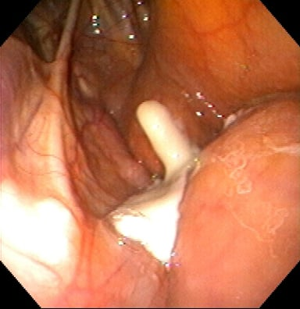
Diagnosis guttural pouch empyema
On endoscopic examination purulent discharge can be seen at the pharyngeal orifice of the affected side, with pharyngeal collapse in some horses
On standing lateral radiographs Fluid accompanied by masses seen within the guttural pouch suggestive of chondroids
Fluid aspirates or saline washings can be taken from the guttural pouch for culture and sensitivity testing

Slide 28
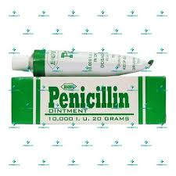
Treatment of guttural pouch empyema
Systemic antimicrobial treatment alone rarely resolves the infection; repeated guttural pouch lavage is necessary
Penicillin gel can be administered directly into the guttural pouch and may enhance bacterial clearance
Retropharyngeal abscesses can sometimes be resolved by rupturing the abscess into the guttural pouch using an endoscopic blade
Tracheotomy may be necessary to provide a temporary alternative airway in these cases.

Slide 29
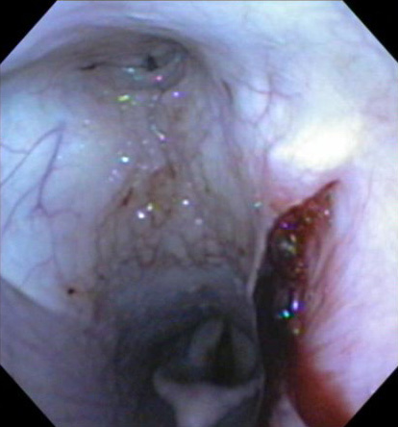
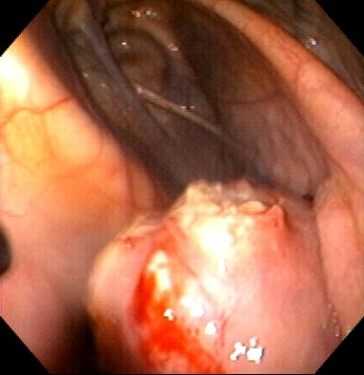
Guttural Pouch Mycosis
Guttural pouch mycosis is a life-threatening condition, primarily affecting adult horses and resulting in fatal hemorrhage in almost 50% of cases
Guttural pouch mycosis affects the roof of one guttural pouch, rarely both
The cause of guttural pouch mycosis is unknown, although Aspergillus can be identified in the lesion
Mycotic plaques form within the guttural pouch and are typically located on the caudodorsal aspect of the medial guttural pouch, over the internal carotid artery.

Slide 30
Clinical signs Guttural Pouch Mycosis
The condition is clinically occult until the fungal plaques damage the cranial nerves and arteries within the guttural pouch
Most common clinical sign is moderate-to-severe epistaxis, which is caused by fungal erosion of the internal carotid artery in most cases and of the external carotid and maxillary arteries in approximately one third of cases
Mucus and dark blood continue to drain from the nostril on the affected side for days after acute hemorrhage ceases.
Second most common clinical sign is dysphagia caused by damage to the pharyngeal branches of the vagus and glossopharyngeal nerves
Dysphagia is a poor prognostic indicator and is highly correlated with non-survival

Slide 31
Treatment of Guttural Pouch Mycosis
Medical treatment can be expensive and prolonged (weeks), consisting of topical and systemic antifungal treatment. Variable success is reported
Additional supportive or medical treatment may be needed depending on the severity of disease or blood loss, and associated neurologic abnormalities.
Surgical occlusion of the affected arteries both proximal and distal to the lesion can be attempted in combination with medical treatment
Options for occlusion include ligation of affected vessels, placement of a balloon-tipped catheter or fluoroscopic-guided transarterial coil embolism. Vessel occlusion is primarily performed to decrease the risk of fatal hemorrhage but may also arrest fungal plaque growth.

Slide 32
